Slide 2
Scope of the Project
Customer Needs
Transfer data wirelessly to an Android phone.
Assembly time less than 5 minutes.
No modifications to pipes; non-intrusive method.
Software must collect, store and display data.
Working Demo.
Diagnostic tools are already being used by GE for compressor performance, but they are…
Too expensive
Time Consuming
Hazardous to Technical Support
Create an non-intrusive flow velocity measurement system to interface with a Google mobile phone application
Notes:
Customer Needs
Transfer data wirelessly to an Android phone.
Assembly time less than 5 minutes.
No modifications to pipes.
Software must collect, store and display data.
Working Demo.

Slide 3
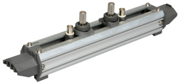
Status Update: Sensors
Currently reverse engineering Fuji sensors
2 MHz
Remove test data from unit
Create data sheet
Sensor spacing
Calibration
Test signal burst method

Slide 4
Status Update: Flow Analysis
Flow Rate: Specifications to meet
PV Curve: If specs not met, used to help diagnose problem in compressor
Obtain Pressure from Velocity Measurement. General Principle:
Volume known from compressor dimensions
Efficiency:

Slide 5
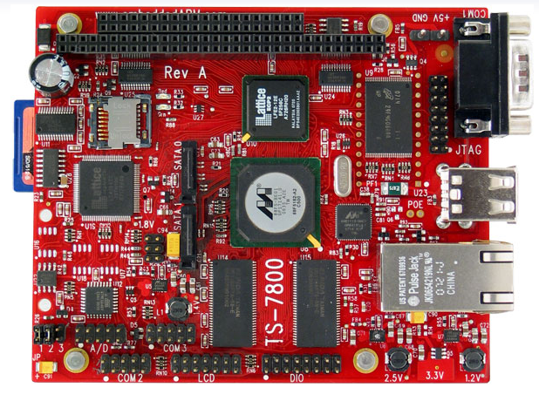
Status Update: Microcontroller
Configuring OS for real-time threads and easier network access through SSH
Setting up for wireless connection to phone
Coding small program to send sample data to phone
Image by: http://www.embeddedarm.com/images/boards/medium/ts-7800.gif

Slide 6
Status Update: Application
Application GUI framework up and running
Initial database coded
Setting up for wireless connection to microcontroller
Once receiving sample data start testing and modifying database if needed
After database is fully functional can start coding calculations and modifying plotting function to correctly display PV graphs
Image by: http://androidplot.com/header/images/upperlogo.jpg
Image by: http://lh3.ggpht.com/-YklDCK49g3Y/TxXg4CCV-ZI/AAAAAAAAARk/_J6nbIrI7go/LG-Optimus-Black-P970_Android-AM_thumb%25255B3%25255D.jpg?imgmax=800

Slide 7
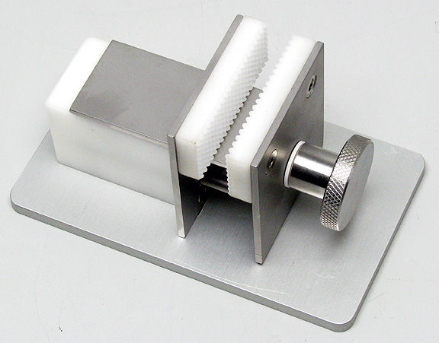
Status Update: Mounting System and Housing
Mounting System is completed
Attaching the housing unit to the track, is being analyze
Torsion spring
Screws (Vise)
Image by: http://www.steritool.com/images/product/vise2.jpg

Slide 8
Summary - Plan of Attack
Work on project segments then combine to make a whole product
Sensors
Housing
Thermodynamics
Microcontroller
Application
Modular Design
Develop and interface components
Test and calibrate system
Modify system for portability and demonstration purposes
ME
EE/CPE
Sensor
Microcontroller
Housing
Thermo
Application

Slide 9
Spring Schedule

Slide 10
Questions
Image Provided by: http://www.datingadvice4christiansingles.com/image-files/askaquestion.jpg

